Slide 1
CD Mini Project
BY:
Jayesh Kumar
(4NM17CS071)
Deon Lobo
(4NM17CS054)

Slide 2
Problem Statement
X: integer ;
Procedure foo( b : integer )
b := 13;
If x = 12 and b = 13 then
printf( “by copy-in copy-out” );
elseif x = 13 and b = 13 then
printf( “by address” );
else
printf( “A mystery” );
end if;
end foo

Slide 3
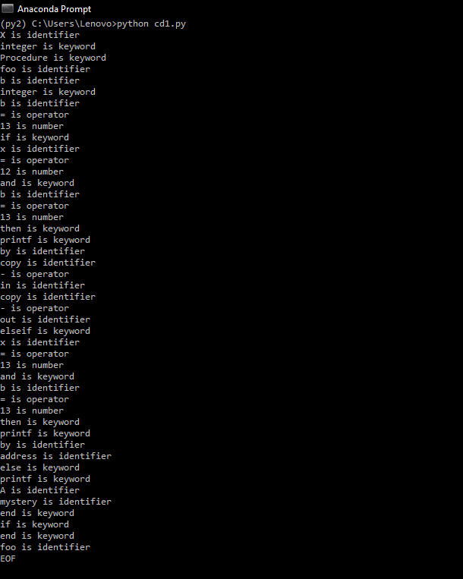
Lexical Analysis

Slide 4
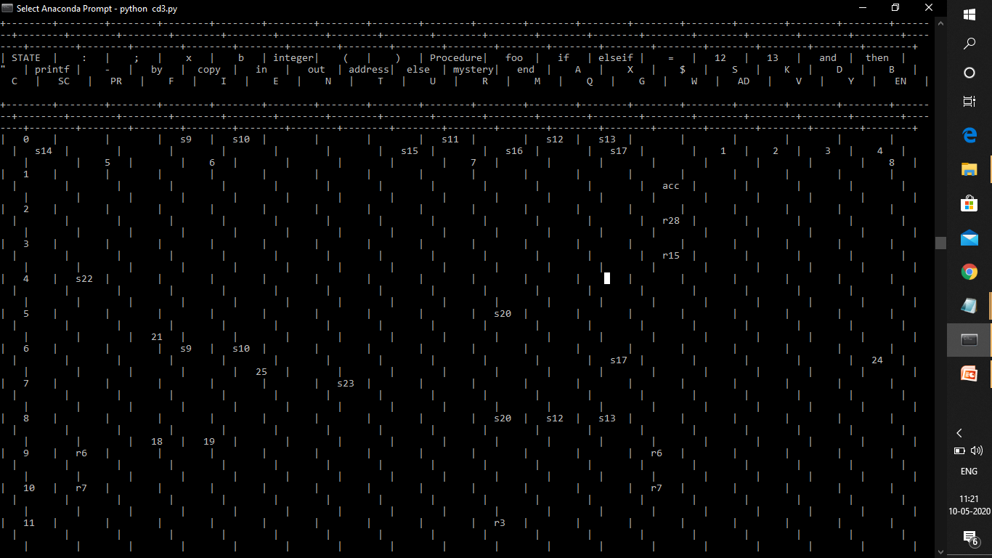
Syntax Analysis-(parsing table)

Slide 5
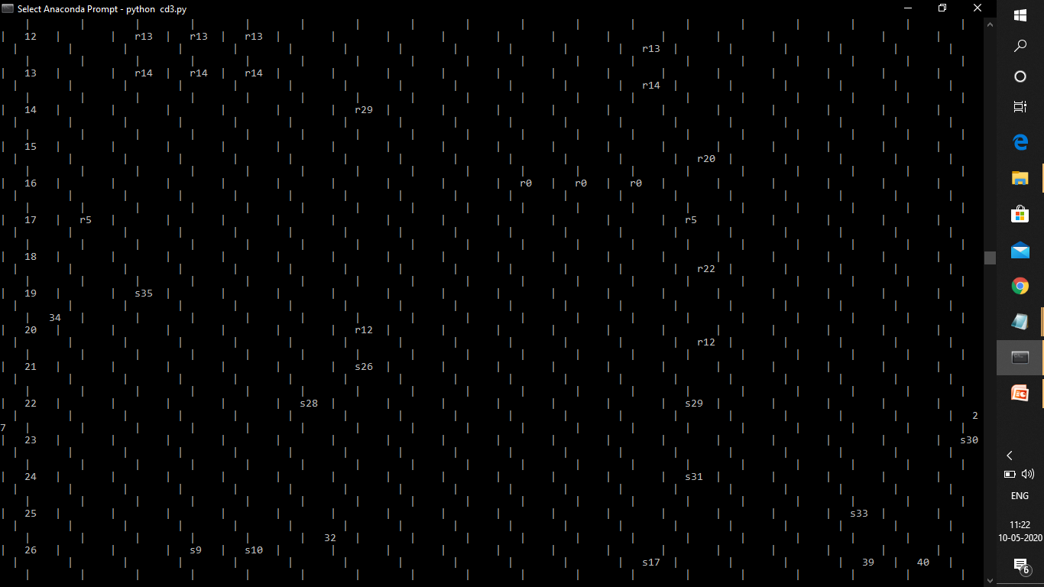

Slide 6
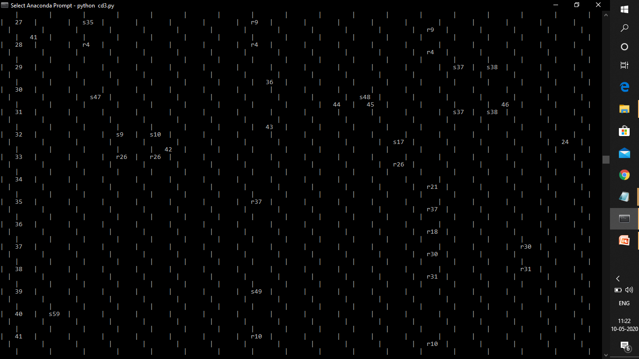

Slide 7
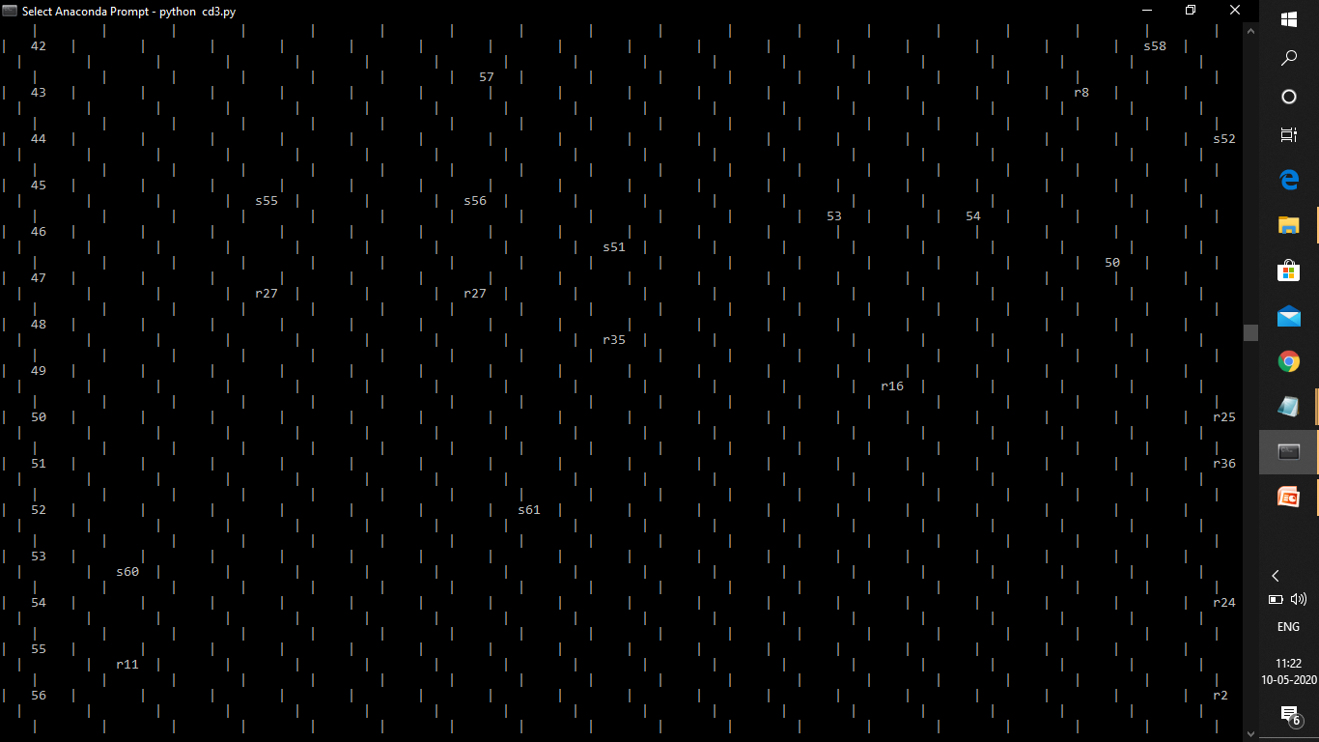

Slide 8
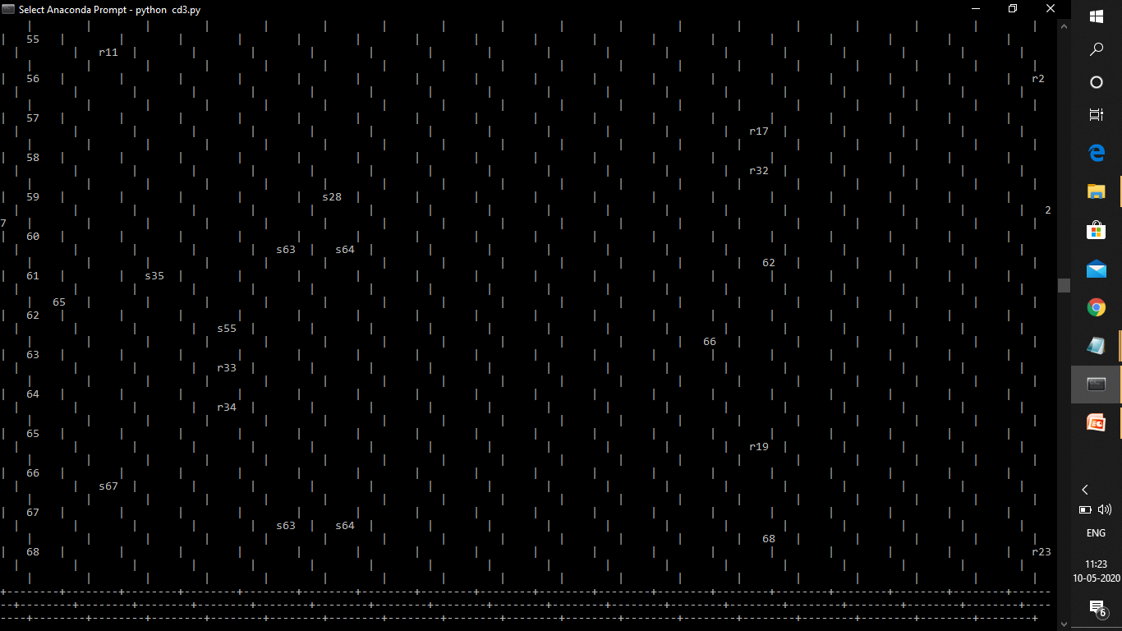

Slide 9
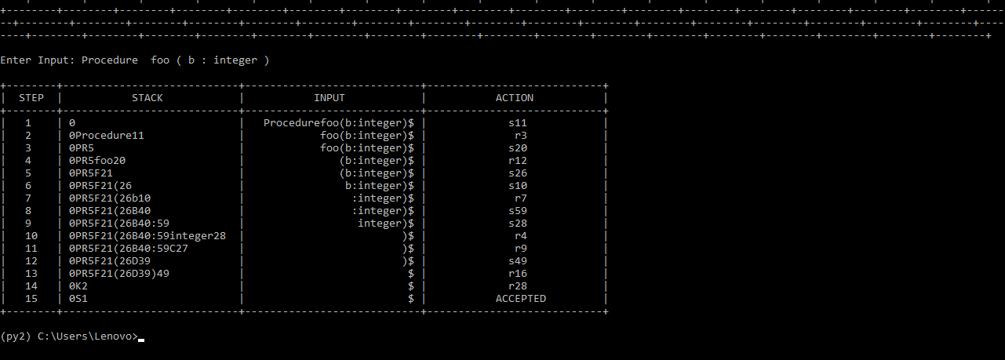
Parsing Steps

